Slide 1
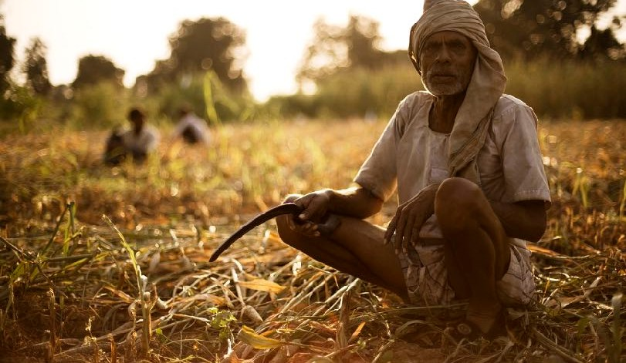
A FARMER’S COMPANION
KISAN SEVA

Slide 2
PROBLEM STATEMENT:
•The lack of smart farming knowledge(such as amount of fertiliser to be used , type of crop to be sown after the nutrient content and texture of soil changes ) among farmers
•Involvement of lots of middlemen and corruption that arises while selling the yield
•Less awareness with respect to the various beneficiary scheme existing for farmers

Slide 3
THEMES COVERED:
Our solution comes under the following themes :
Governance :Helps government to implement the schemes for farmer in a efficient way as it emphasises on the awareness among the farmers
•Digital Inclusion :Digital inclusion has three broad facets: access, adoption, and application. These facets show the ultimate goal of creating digitally inclusive farmer communities.
1.Access: Availability, affordability, design for inclusion, and public access. 2.Adoption: Relevance, digital literacy, and consumer safety.
3.Application: Economic and workforce development, education, health care, public safety and emergency services, civic engagement, and social connections.

Slide 4
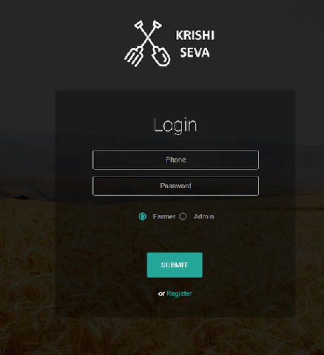
ABOUT:
To assist farmer on the part of :
▸ Smart Farming
▸ Government schemes of interest
We have developed a website and an android app that highly farmer friendly and clean i.e easy to use with minimal text.

Slide 5
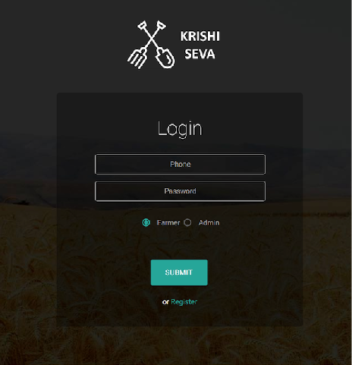
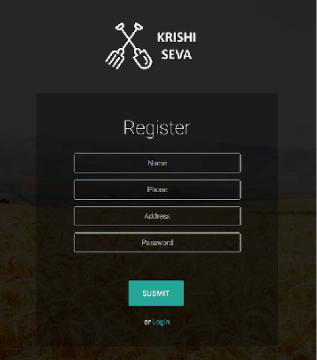
PRODUCT
Website

Slide 6
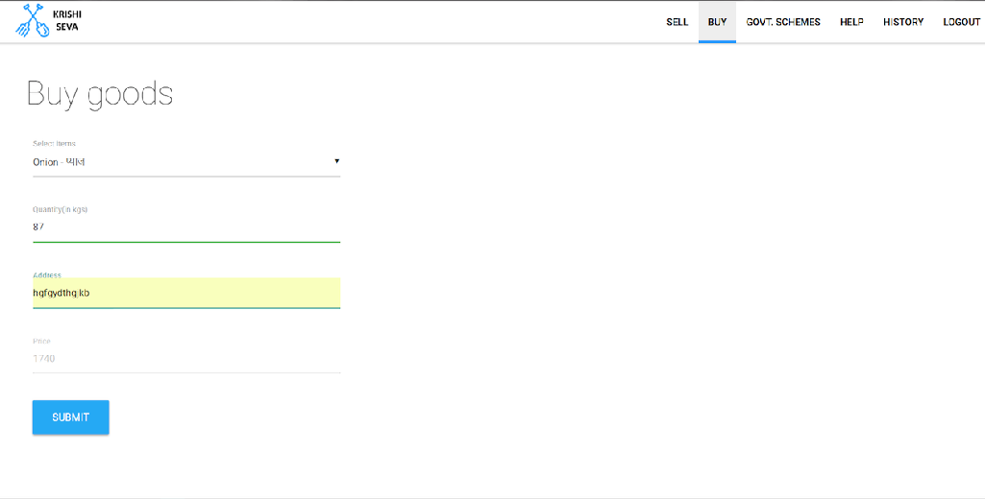

Slide 7
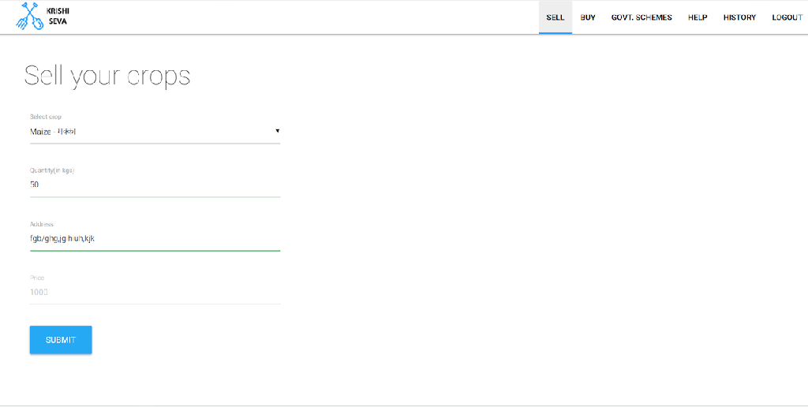

Slide 8
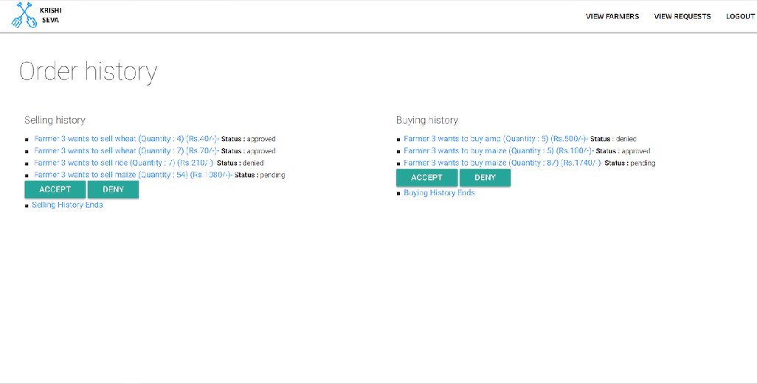

Slide 9
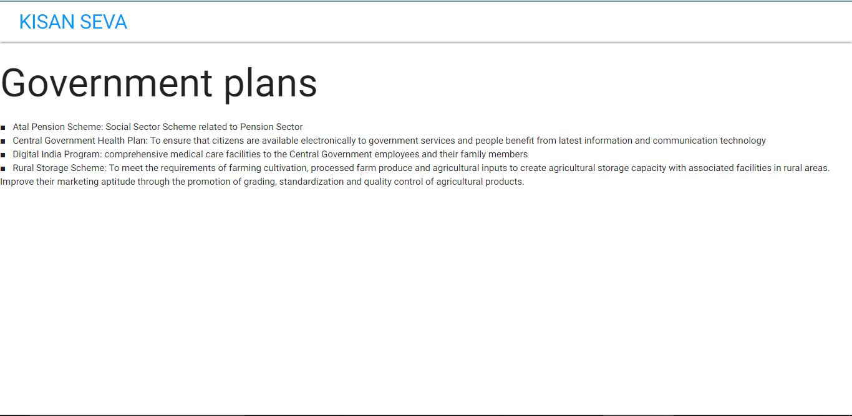

Slide 10
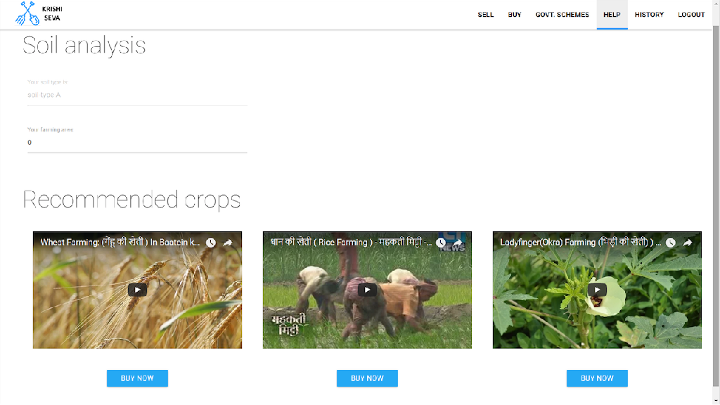

Slide 11
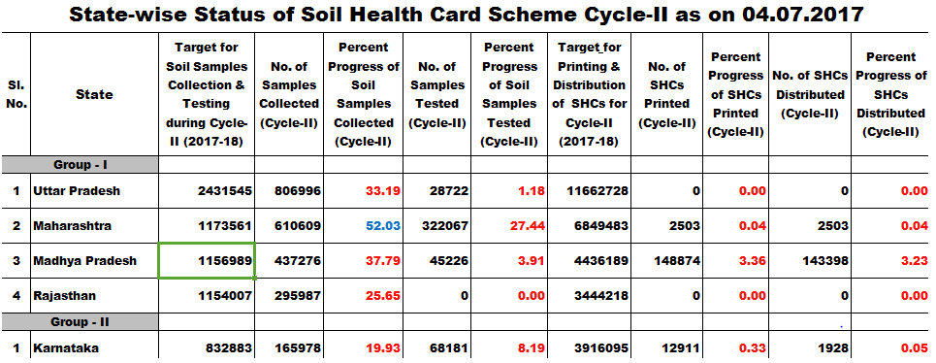
Data Source

Slide 12
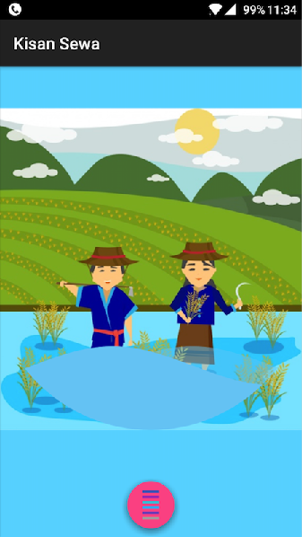

ANDROID APP

Slide 13
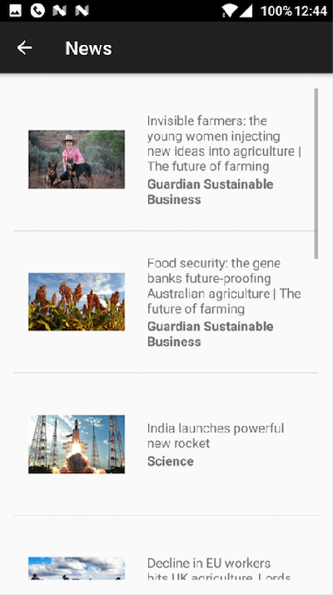
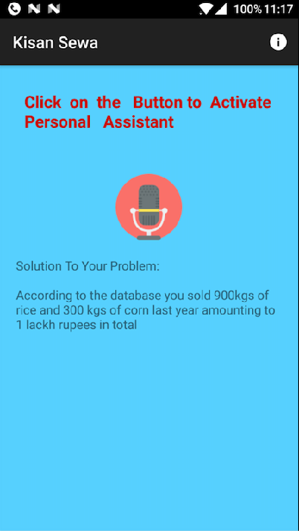

Slide 14
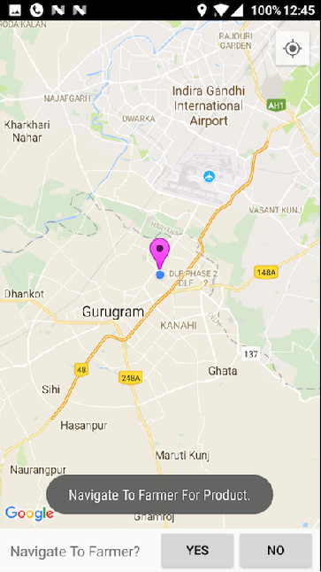
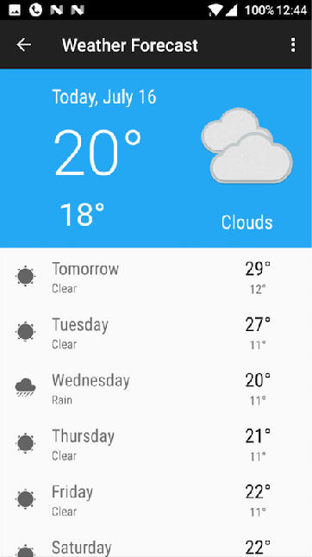

Slide 15
OPPORTUNITIES:
▸ With Modi government targeting pan India digitalisation by building infrastructure to support digital needs by 2020 , it is high time to include the farmer digitally and introduce them with the benefits and opportunities of going digital and using technology
▸ Much hyped transparency can be achieved implying this solution
▸ With the gradual development in this product , we are planning to introduce crop insurance , so as to provide the back to the farmers as per the governments schemes. So that they can be relieved from the tension of unexpected crop failure, which is of course the main reason of suicide.

Slide 16
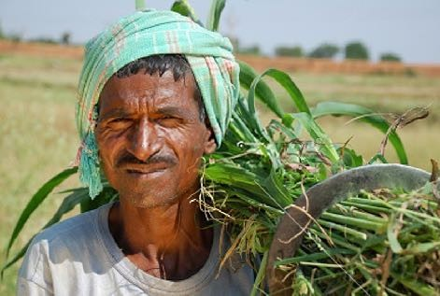
S O C I A L I M P A C T
▸ Will help in reducing farmer’s suicide due to crop failures thus saving innocent and precious life
▸ Lessen the hoarding of
stock ,which ultimately may reduce inflation of market price of stuff like vegetables , cereals etc
▸ Bridge the gap between Farmer and government

Slide 17
T H A N Q

